Slide 1
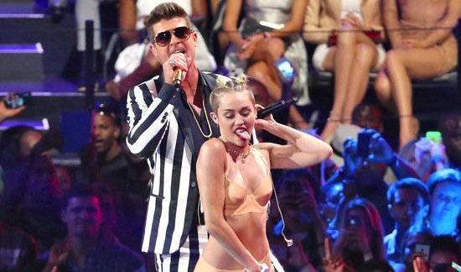
Group 2
Amy Hu 9A
Charlene Pan 9B
Carter 9A

Slide 2
The news value of this picture
1.Timeliness
2.Prominence
3.Novelty

Slide 3
Who?
The main people in the picture are Miley Cyrus and probably a singer or host.

Slide 4
What?
Maybe it’s a concert or a TV show or a celebrity.

Slide 5
Where?
It’s probably at an auditorium, a stadium or a TV show spot.

Slide 6
When?
Recently.

Slide 7
Why?&how?
For money, fame and leading her to a new stage. She changed her style for sensationalization , and make her audiences to buy her tickets and go to her concert.

