Slide 1
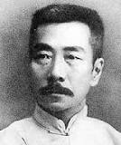
Luxun
China’s Greatest Modern Writer

Slide 2
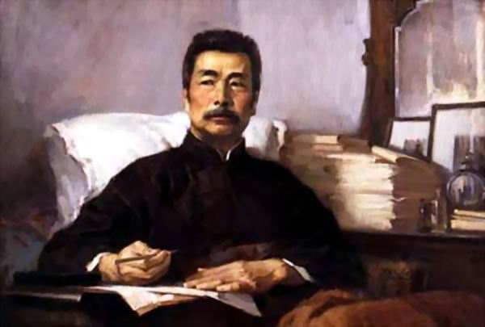
Who is Luxun?
Mr.Zhou Shuren?
A great author?
A great Chinese?
Or?

Slide 3
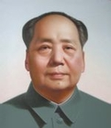
Mao Zedong called him:
“ the commander of China's cultural revolution”

Slide 4
What did he do?
He worte:
A Madman's Diary (April 1918) Kung I-chi (March 1919) Medicine (April 1919) Tomorrow (June 1920) An Incident (July 1920) Storm in a Teacup (October 1920) My Old Home (January 1921) The True Story of Ah-Q (December 1921) Preface to “Call to Arms” (December 3, 1922) Village Opera (October 1922)
……………..

Slide 5
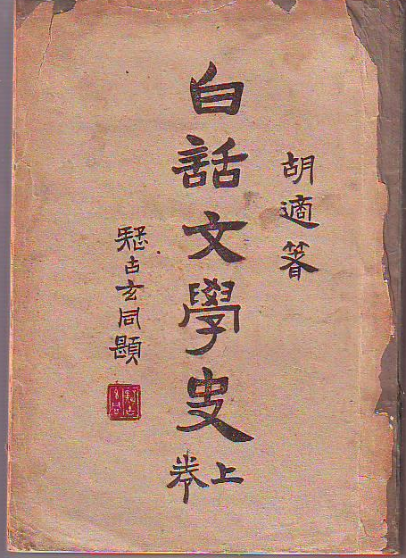
The most important thing he did is:
The Vernacular Revolution

Slide 6
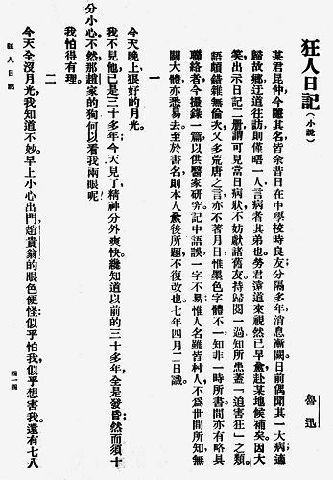

Slide 7
What is Vernacular Revolution?
The people used to write with the ancient Chinese to write the passages but they used modern Chinese to talk.This was so weird so some people decided to change that habit.

Slide 8
How did he make change?
He was the first one publish the articles written with modern Chinese while other authors were afraid about the policies.

Slide 9
In brief，
Luxun is truely a person who fight with those old-fashioned policies with his own pen.He also changed the Chinese literature.

Slide 10
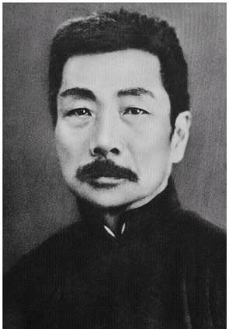
Hats off to the Great Luxun!

Slide 11
Thank you for watching.
Present by Amy Hu 9A
Sourse:Asia for Educator & Marxists Reference Org.& The text book.

